Slide 1
Predicting Labels for GitHub Issues
Team:
Harsh Agrawal
Siddu Madhure Jayanna

Slide 2
Background & Motivation:
Over the past year, 10M new developers joined the GitHub community, contributing to 44M+ repositories across every continent on earth.
40M+ developers on GitHub including 10M new users in 2019
44M+ repositories created in the last year.
87M+ pull requests merged in the last year
20M+ issues closed in the last year - That’s a lot of decisions made, bugs fixed, and features implemented!
Source: https://octoverse.github.com/

Slide 3
Introduction:
Is it really important to have labels for GitHub Issues??
Labels on GitHub help us organize and prioritize our project tasks
Big active Repositories -> Tons of new issues created everyday -> Manual labor to identify and assign appropriate labels
What if the new issues created are not labelled ??
Focus on what matters the most and automate everything else with ML powered Bots

Slide 4
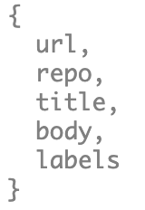
Data Collection:
Dataset downloaded from Github Archive stored in Google BigQuery. We downloaded all the issues:
That have a label and are opened between 2017 to 2019
With title length between 3 to 50 words
With body length between 6 to 1000 words
Ignored the issues marked ‘duplicate’
Out data contains Repo, Link, Body, Title, and Labels

Slide 5
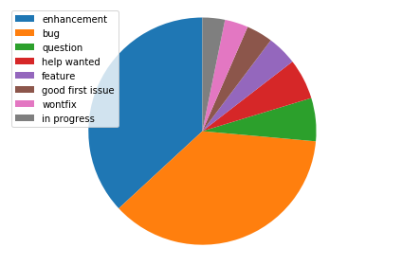
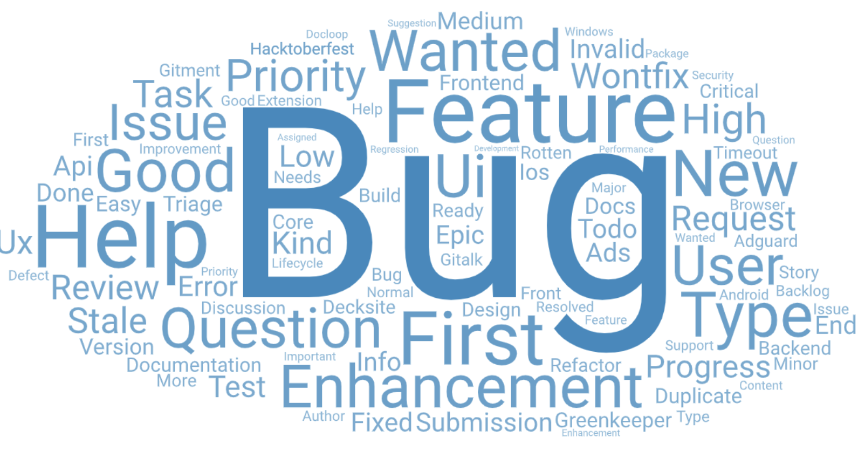
Data Analysis:
Most common labels - Bug, Enhancement & Question
Training Data - 1.8 mil Issues
Around 0.8 mil enhancement
Around 0.8 mil bug
Around 0.2 mil question
Testing data - 0.3 mil issues

Slide 6
Data Preprocessing:
Data was processed using ‘ktext’ which is a data preprocessor written by developers at github. Steps involved:
Cleaning: Removing emails, code, HTML tags
Tokenization: “Is this a bug” -> [‘is’, ‘this’, ‘a’, ‘bug’]
Creating vocabulary: Creating a dict of all the words found in the text.
Vectorization: Replacing all the words with a same integer value
Padding and Truncation: Adding 0s to the smaller strings, Removing least common words from longer strings

Slide 7
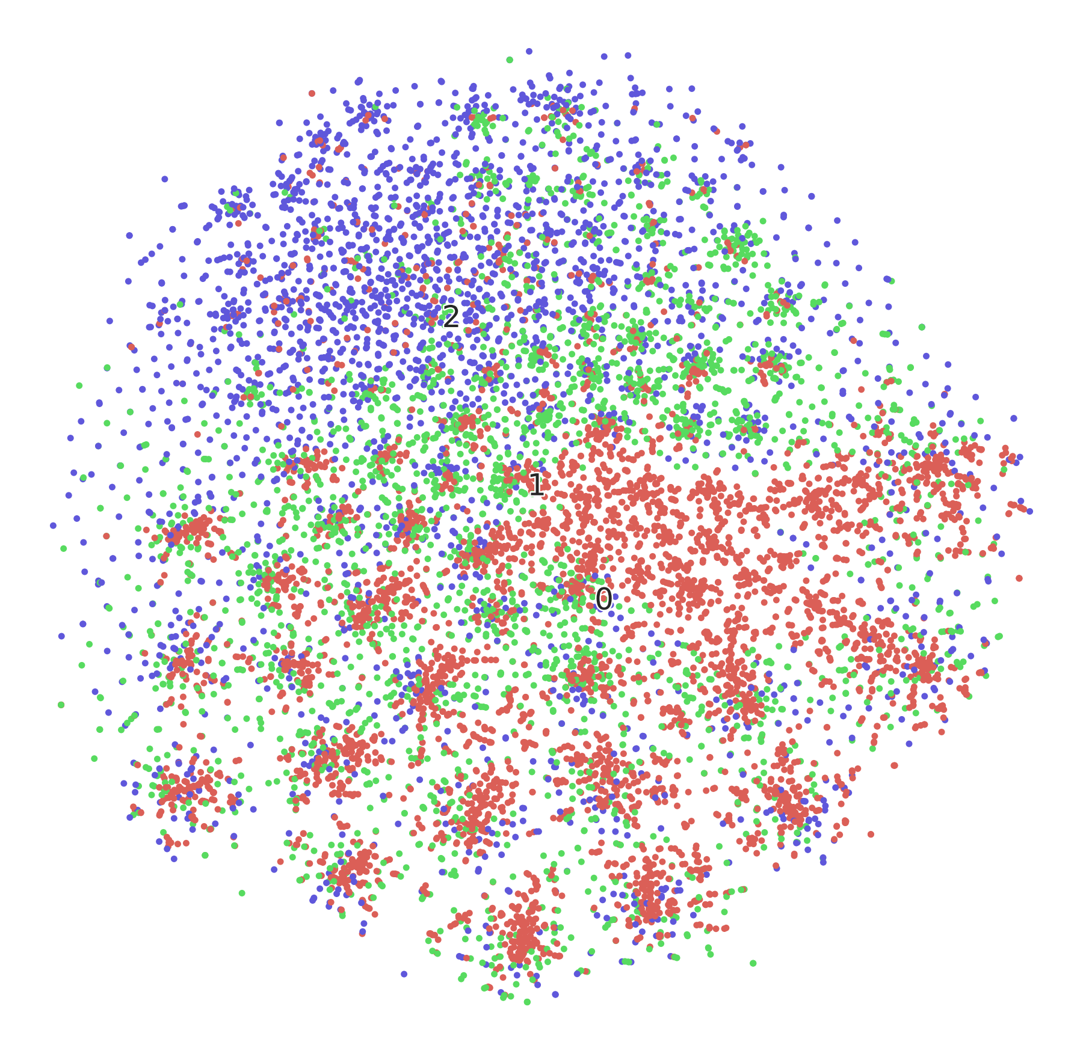
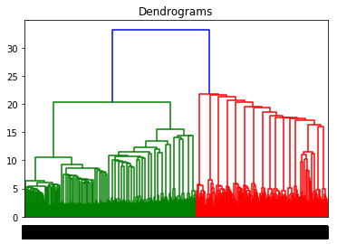
Clustering
Hierarchical clustering
t-SNE(t-Stochastic neighbor embedding)

Slide 8
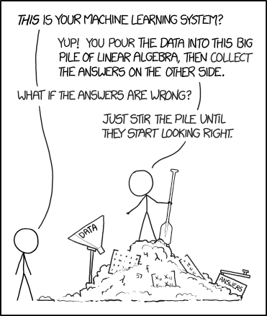
Models:
Deep Neural Network
SVM
Decision Tree

Slide 9
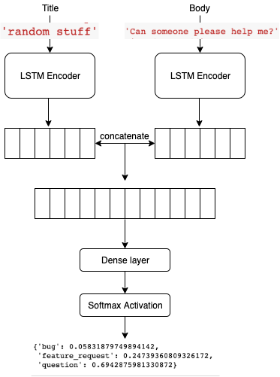
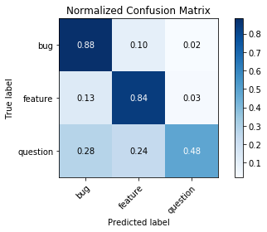
DNN Architecture:
50 GRU (LSTM)
1 fully connected layer
1 activation layer
Results:

Slide 10
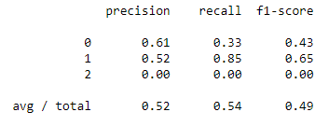
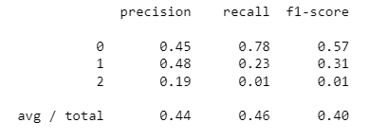
SVM and Decision Tree Results
SVM - Test Accuracy: 54.2 %
Decision Tree - Test Accuracy: 45.5 %

Slide 11
Improvement Strategies: Beyond Being Naive!
Can we use some unsupervised learning techniques?
Can clustering techniques be used to improve the performance of classification models ??
So we have 100-D data here - that’s so huge! Can we try PCA ??

Slide 12
Clustering:
Clustering apart from being an unsupervised machine learning can also be used to create clusters as features to improve classification models.
Approach 1: Prediction using only KMeans’s clusters
Only clusters found by KMeans are used to train a classification model (SVM) - Not Efficient
Approach 2: Prediction using KMeans’s clusters and a classifier model (SVM)
Using the clusters as features with other existing features - Improves model accuracy
Approach 3: Try PCA for dimensionality reduction.

Slide 13


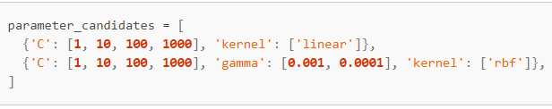
Optimize!
GridSearchCV
HyperParameter Tuning

Slide 14
Takeaways
Clustering apart from being an unsupervised machine learning can also be used to create clusters as features to improve classification models.
Inconsistency of data plays a big role in model generation.
Large quantities of data cannot not guarantee a good model.
Selecting the right type of data and hyperparameters is important.
Notes:
Clustering techniques on their own aren’t enough for classification. But when used as features, they improve model accuracy.

Slide 15
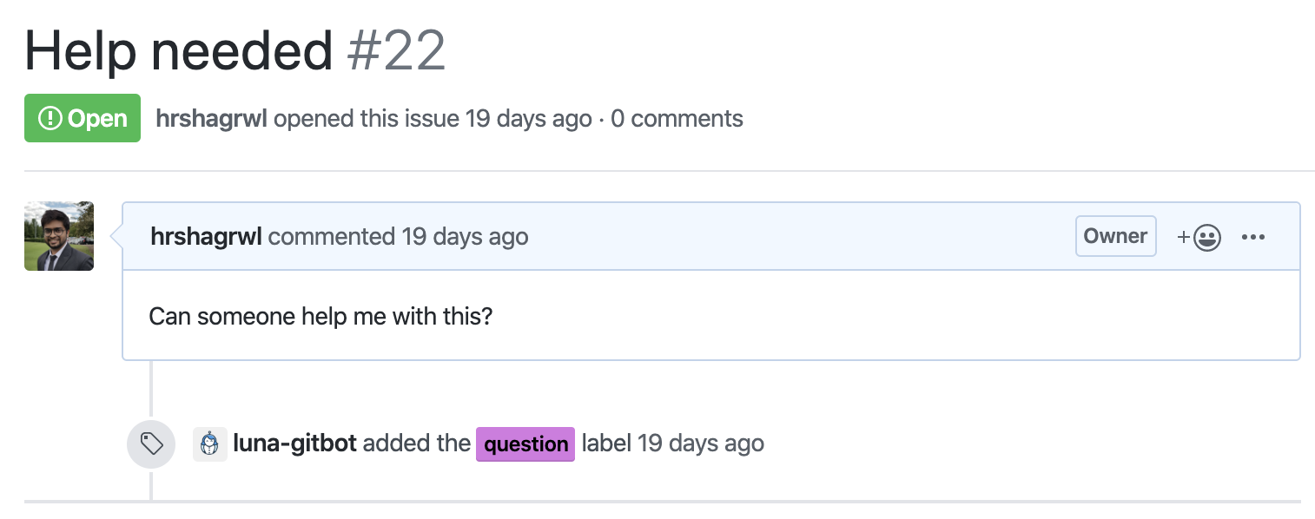

We are our first customer!

Slide 16
Business Opportunity:
Vision: From Idea to Profitable Business on the GitHub Marketplace and Slack
Automate manual and mundane tasks to save time and manpower - It took almost 60 mins to label 100 issues manually.
Even a product with little differentiated value can be successful if we can reach a lot of people and sell it well.

Slide 17
References:
https://blog.keras.io/a-ten-minute-introduction-to-sequence-to-sequence-learning-in-keras.html
https://towardsdatascience.com/how-to-create-data-products-that-are-magical-using-sequence-to-sequence-models-703f86a231f8
https://www.gharchive.org/
https://towardsdatascience.com/plotting-text-and-image-vectors-using-t-sne-d0e43e55d89
https://www.kaggle.com/pranathichunduru/svm-for-multiclass-classification/notebook

Slide 18
